Slide 1
Basics of Python

Slide 2
Python
Version-3

Slide 3
Index
Types
Expressions and Variables
String operations
Input and output
Lists and Tuples
Dictionaries
Sets
Conditions and Branching
Loops
Functions
Objects and Classes

Slide 4
PYTHON TYPES

Slide 5
Python Types
11 # integer

Slide 6
Python Types
11 # integer
561.73 # Float

Slide 7
Python Types
11 # integer
561.73 # Float
“Hello!” # String

Slide 8
Python Types
Type function:
type(Expression)→ Datatype

Slide 9
Python Types
Type function:
type(11) → Integer
type(561.73) → Float
type(“Hello!”) → String

Slide 10
Type Casting:
Type casting is a process of converting one data type into another data type.
Python Types

Slide 11
Type Casting : Examples
float(11) → 11.0
int(561.23) → 561
int(“Hello!”) → Error
int(“15”) → 15
str(1.25) → “1.25”
Python Types

Slide 12
Python Types
Type Boolean :
True
False

Slide 13
Python Types
Type Boolean :
type(True) → bool
type(False) → bool
int(True) → 1
bool(1) → True

Slide 14
PYTHON EXPRESSIONS AND VARIABLES

Slide 15
Expressions and
Variables
Expressions :
Expressions describe a type of operations that computers perform.
Expressions are operations the python performs, for example, basic arithmetic operations like adding multiple numbers.

Slide 16
Expressions and
Variables
Expressions :
Example-1 :
1+2+3+4-5+6+7+8+9+10 = 45
Here,
1 to 10 → Operands
+, - → Operators

Slide 17
Expressions and
Variables
Expressions :
Example-2:
10*6 = 60
Example-3:
20/4 = 5.0 → This is regular division
20//4 = 5 → This is called integer division

Slide 18
Expressions and
Variables
Variables :
Variables can be used to store values and to perform operations.
In python we need not initialize variables with their datatypes and is automatically type casted when required.

Slide 19
Expressions and
Variables
Variables :
Example-1:
A = 5
B = 20
C = A*B-50
Value of C → 50

Slide 20
Expressions and
Variables
Variables :
Example-2:
A = 5+20+25
B = A-15
Value of A → 50
Value of B → 35

Slide 21
Expressions and
Variables
Variables :
Example-3:
A = 25
A = A*4
Value of A → 100

Slide 22
PYTHON STRINGS

Slide 23
Strings
In Python, a string is a sequence of characters.
A string is contained within two quotes. We can also use single quotes.
A string can be spaces or digits.
A string can also be special characters.
We can bind or assign a string to another variable.
It is helpful to think of a string as an ordered sequence.

Slide 24
Strings
Example:
String1 = “Machine Learning”
or
‘Machine Learning’

Slide 25
Strings
Example:
String1 = “Machine Learning”
or
‘Machine Learning’
+ 0 1 2 3 4 5 6 7 8 9 10 11 12 13 14 15
- -16 -15 -14 -13 -12 -11 -10 -9 -8 -7 -6 -5 -4 -3 -2 -1
M | a | c | h | i | n | e |  | L | e | a | r | n | i | n | g

Slide 26
Strings
Example:
0 1 2 3 4 5 6 7 8 9 10 11 12 13 14 15
Now,
String1[0] → “M”
String1[8] → “L”
String1[-13] → “h”
M | a | c | h | i | n | e |  | L | e | a | r | n | i | n | g

Slide 27
Strings
Example:
0 1 2 3 4 5 6 7 8 9 10 11 12 13 14 15
String slicing
String1[0:4] → “Mach”
String1[8:12] → “Lear”
String stride
String1[::2] → “McieLann”
String1[0:9:2] → “McieL”
M | a | c | h | i | n | e |  | L | e | a | r | n | i | n | g

Slide 28
Strings
Example:
0 1 2 3 4 5 6 7 8 9 10 11 12 13 14 15
String Length function
len(“String1”) → 15
String manipulations
String2 = String1 + “with Python”
String2 → “Machine Learning with Python”
String3 = 2*String1
String3 → “Machine Learning Machine Learning”
M | a | c | h | i | n | e |  | L | e | a | r | n | i | n | g

Slide 29
Strings
Example:
0 1 2 3 4 5 6 7 8 9 10 11 12 13 14 15
Strings are immutable
We cannot change the value of a string.
String1[0] = “F”
M | a | c | h | i | n | e |  | L | e | a | r | n | i | n | g

Slide 30
Strings
Example:
0 1 2 3 4 5 6 7 8 9 10 11 12 13 14 15
Escape sequences:
\n → For a new line
\t → For a new tab space
M | a | c | h | i | n | e |  | L | e | a | r | n | i | n | g

Slide 31
Strings
Example:
0 1 2 3 4 5 6 7 8 9 10 11 12 13 14 15
Escape sequences:
Examples:
print(“Machine \n Learning”)
Output → Machine
Learning
print(“Machine \t Learning”)
Output → Machine Learning
M | a | c | h | i | n | e |  | L | e | a | r | n | i | n | g

Slide 32
String Methods:
Python has a set of built-in methods that you can use on strings.
All string methods returns new values.
They do not change the original string.
Let’s suppose two strings ‘A’ and ‘B’
A → Method → B
Strings

Slide 33
String Methods:
Example - 1:
A = “Machine Learning with Python”
Let’s try method “upper”
B = A.upper()
print(B)
Output
MACHINE LEARNING WITH PYTHON
Strings

Slide 34
String Methods:
Example - 2:
A = “Machine Learning with Python”
Let’s try method “replace”
B =A.replace(‘Python’, ‘R’)
print(B)
Output
MACHINE LEARNING WITH R
Strings

Slide 35
Taking inputs
We can use “input()” to take inputs.
But in python 3, default type of the value taken as input is string.
So if we want to take any other data type inputs, we must specify it.
And for outputs we can simply use print statement.
Inputs
And
Outputs

Slide 36
Example:
String_input = input()
print(String_input)
Integer_input = int(input())
print(Integer_input)
print(Integer_input + 1)
Float_input = float(input())
print(Float_input)
Inputs
And
Outputs

Slide 37
PYTHON Lists and Tuples

Slide 38
Tuples:
In python tuples are an ordered sequences.
Tuples are immutable.
They are written as comma-separated values.
Tuples can be nested
Example:
Exampletuple=(1,9,6,8)
Python
Lists and Tuples

Slide 39
Tuples:
All the three data types in python can be contained in tuples.
Example
tuple2=(‘ML’, 1, 95.68)
Type of any tuple is the same
type(tuple2) → tuple
Python
Lists and Tuples

Slide 40
Lists:
In python lists are an ordered sequences and is represented in square brackets.
Lists are very similar to tuples
Only difference between lists and tuples is that lists are mutable
Example:
L=[“Machine Learning”, 10 ,5.2]
Python
Lists and Tuples

Slide 41
Lists:
We can nest lists into lists.
We can also nest tuples into lists
Example:
L=[“Machine Learning”, [10 ,5.2], (“A”,1)]
Python
Lists and Tuples

Slide 42
PYTHON Dictionaries

Slide 43
Dictionaries:
Dictionaries are a type of collection in Python.
These are like addresses.
A dictionary has keys and values.
The keys are like addresses but they don't have to be integers and are usually characters.
Python
Dictionaries

Slide 44
Dictionaries:
The values are similar to the element in a list and contain information.
To create a dictionary, we use curly brackets.
Keys must be immutable and unique.
Each key is followed by a value separated by a colon.
Python
Dictionaries

Slide 45
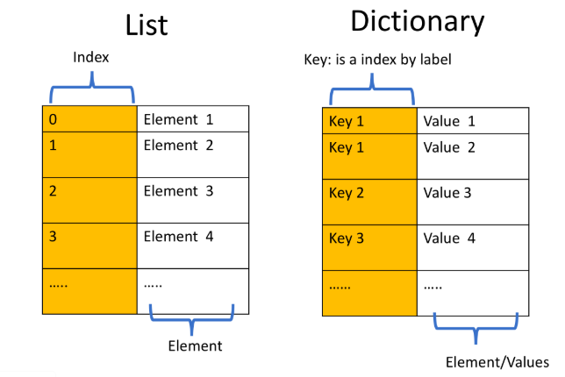
Dictionaries:
Python
Dictionaries

Slide 46
Dictionaries:
The values can be immutable, mutable, and duplicates.
Each key and value pair is separated by a comma.
Python
Dictionaries

Slide 47
PYTHON Sets

Slide 48
Sets:
Sets are a type of collection of elements.
Unlike lists and tuples, these are unordered.
These only have unique elements.
Sets are represented using curly brackets.
Python
Sets

Slide 49
Sets:
Example:
Set1={“A”, “AI”, “ML”, “A”, “B”}
Set1 is stored as
Set1 →{“A”, “AI”, “ML”, “B”}
Python
Sets

Slide 50
Sets:
We can also convert a list into a set. This process is called type casting.
Using:
set_list=set(nameofthelist)
Python
Sets

Slide 51
Sets:
Set operations:
Add
Remove
In – True/False
Union
Intersection
Python
Sets

Slide 52
PYTHON Conditions and Branching

Slide 53
Conditions and Branching
Conditions are branching :
If
Elif
else

Slide 54
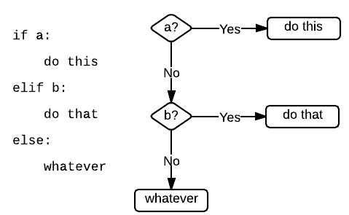
Conditions are branching :
Conditions and Branching

Slide 55
PYTHON Loops

Slide 56
Loops
Loops:
For
While

Slide 57
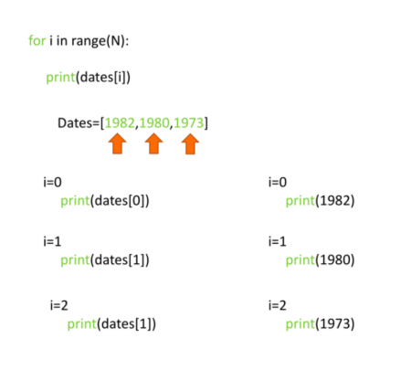
Loops
Loops: for

Slide 58
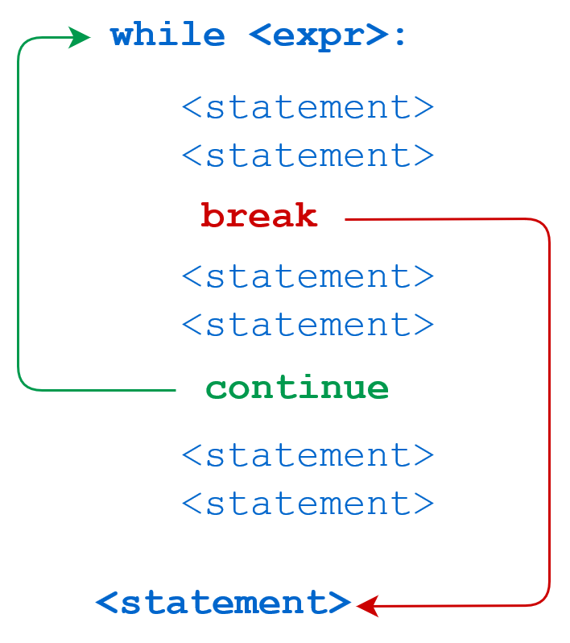
Loops
Loops: while

Slide 59
PYTHON Functions

Slide 60
Functions
Functions are blocks of code which can be used on a call.
Python consists of many inbuilt functions.
Functions can also be defined by the user

Slide 61
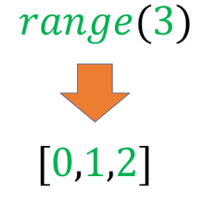
Functions
Example:
Range function-

Slide 62
PYTHON Objects and Classes

Slide 63
Objects and Classes
Objects in programming are like objects in real life.
Like life, there are different classes of objects.
Instances of a Class: Objects and Attributes
An instance of an object is the realisation of a class

Slide 64
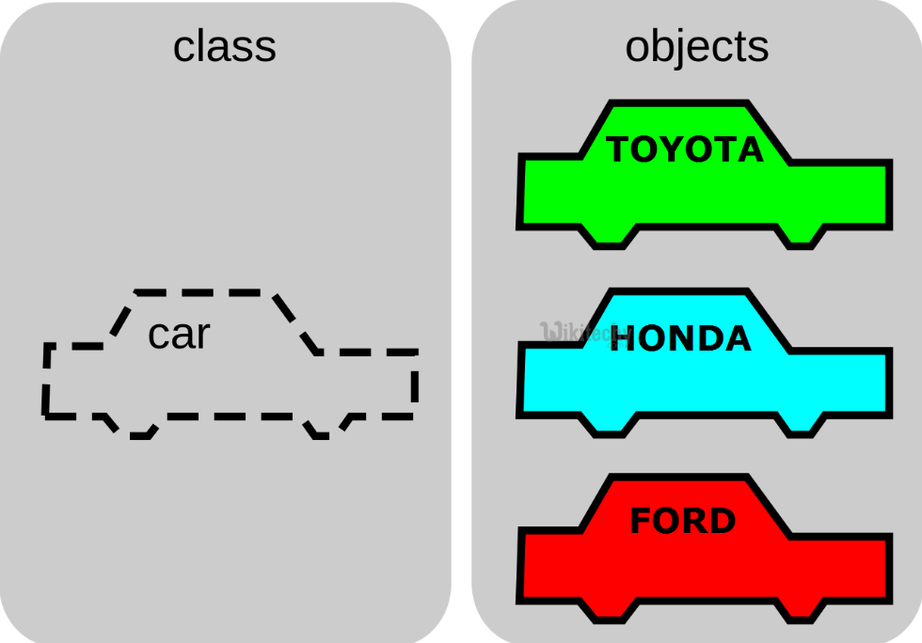
Objects and Classes

Slide 65
Thank You

